Slide 1

Physics

Slide 2
Unit one:The physical measurement
Lesson 1: measurements in physics
Lesson 2 :basic and derived quantities
Lesson 3: length and time measurements
Lesson 4: mass and weight measurements
Lesson 5: accuracy and error

Slide 3
What do you know about physics

Slide 4


Slide 5
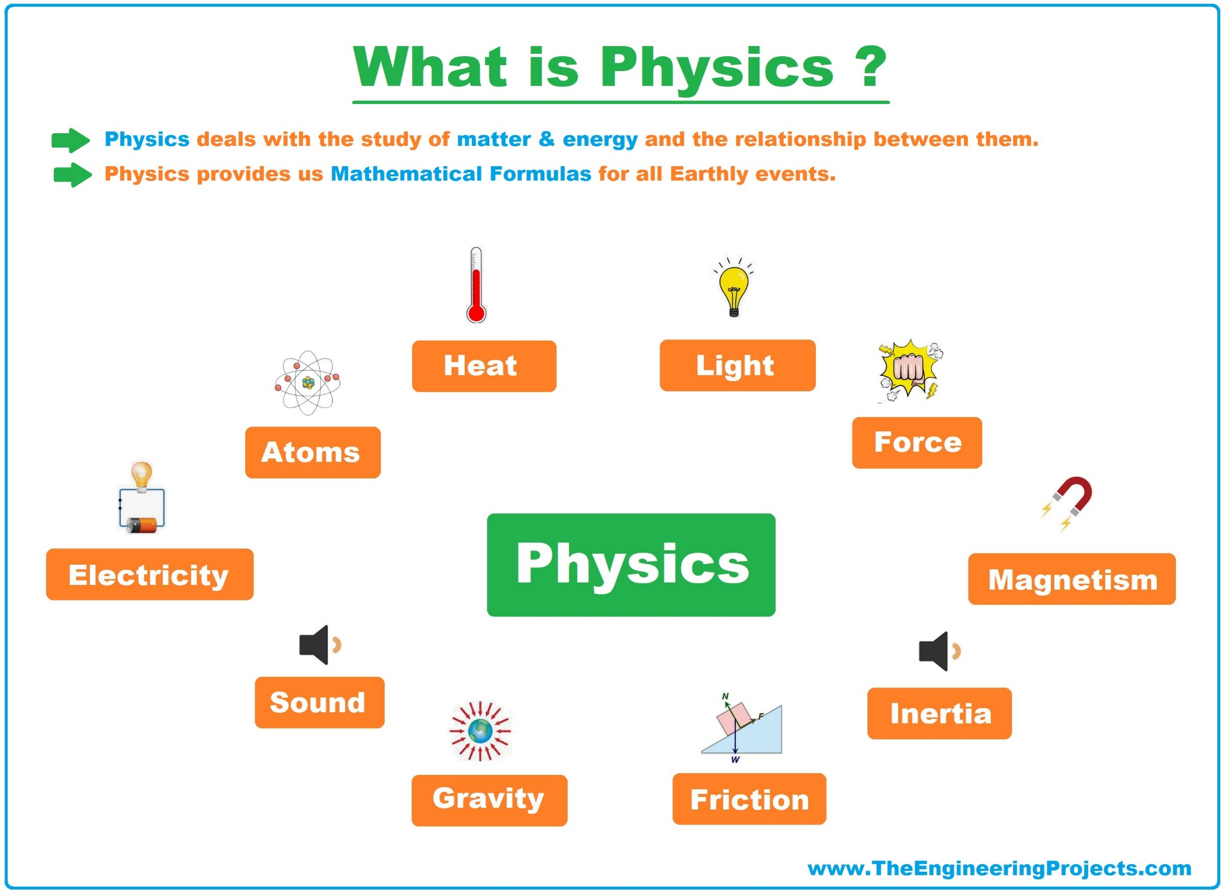
Physics
involves the study of everything in physical existence, from the smallest subatomic particles to the entire universe.

Slide 6
Measurement

Slide 7
Temperature of a person
High
40 c
Inaccurate
Accurate

Slide 8

Measurement
is the process of comparing an unknown quantity with another quantity of its kind (called the unit of measurement) to find out how many times the first includes second

Slide 9
Elements of measurements process

Slide 10
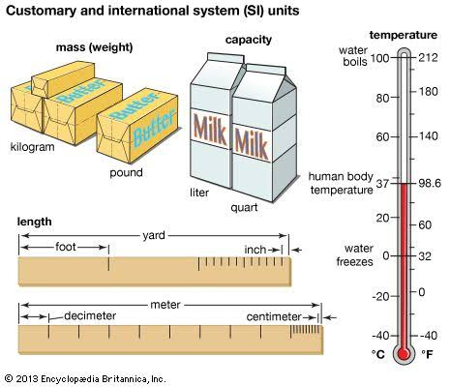
Elements of measurements process
The measurement process has three main elements:
1- The physical quantity to be measured.
2- The necessary measuring tools.
3- Units of measurement used.

Slide 11
What is the physical quantities that you know ?

Slide 12
The physical quantities
Length
Time
Mass
Area
Volume
Force

Slide 13
The Basic quantities
Length
Time
Mass

Slide 14
Standards of Length, Mass, and Time
length (L), mass (M), and time (T) all other physical quantities can be constructed from these three.
To communicate the result of a measurement of a certain physical quantity, a unit for the quantity must be defined.
The fundamental unit of length is defined to be one meter (1m).
The fundamental unit of mass is defined as one kilogram (1 kg).
The fundamental unit of time is defined to be one second (1 s).

Slide 15
Systems of measurements units

Slide 16
Systems of measurements units
International System of Units (SI
The French System( Gaussian System)(C.G.S)
The British System(F.P.S)

Slide 17
International System of Units (SI):
The international system of units is used in all the scientific fields all over
the world.

Slide 18
Units of Measurement
There are several systems used all over the world to determine the fundamental physical quantities and their measuring units.
The Fundamental Quantity | The French System ( Gaussian System) (C.G.S) | The British System (F.P.S) | The Metric System (M.K.S)
Length | Centimeter | Foot | Meter
Mass | Gram | Pound | Kilogram
Time | Second | Second | Second

Slide 19
Measurement Tools

Slide 20
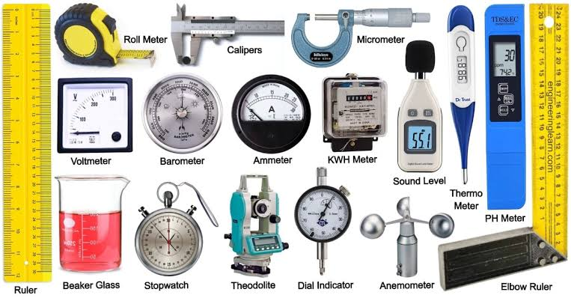
Measurement Tools
Various measurements systems originated and developed in different countries
these tools were very helpful to man in describing phenomena accurately and exploring facts.

Slide 21
The unit of measuring the physical quantity:
We get the unit of measurement by substituting the symbols of dimensions by the proper units.
For instance, the measuring unit of speed is m/s and the measuring unit of acceleration is m/s²

Slide 22
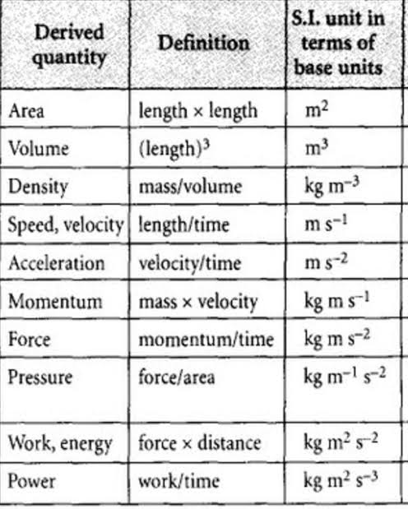
Measuring units of some physical quantities

Slide 23
Important notes
1- To add or subtract two physical quantities, they must be of the same kind having the same dimensions. You cannot add a mass to a length.
2- If the two quantities are of the same kind but having different units, one unit should be converted into the other unit to be added or subtracted.
3- Multiplying or dividing physical quantities of different dimensions gives a new physical quantity; for example dividing distance over time gives speed

Slide 24
Conversion of Units
Sometimes it’s necessary to convert units from one system to another.
Conversion factors
between the SI and (F.P.S), (CGS) systems for units of length and mass are as follows:
1 ft = 0.304 8 m = 30.48 cm
1lb = 0.4536 kg = 453.6 g

Slide 25
KM
CM
X 10^-3
X 10^-2
KM
M
cm
X 10^3
X 10^2

Slide 26
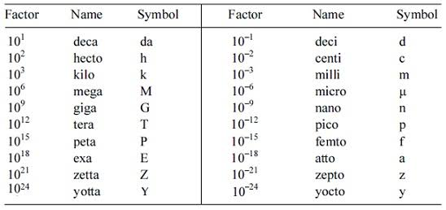
Prefixes of SI units

Slide 27
One kilometer (km) = 1 × 10³ m
One milliamper (mA) = 1 × 10⁻³ A
Three Mega joule (MJ) = 3 × 10 ⁶ J
Five micro coulomb (µC) = 5 × 10⁻⁶ C
1 femto second (fs) = 1 ×10 ⁻¹⁵ s

Slide 28
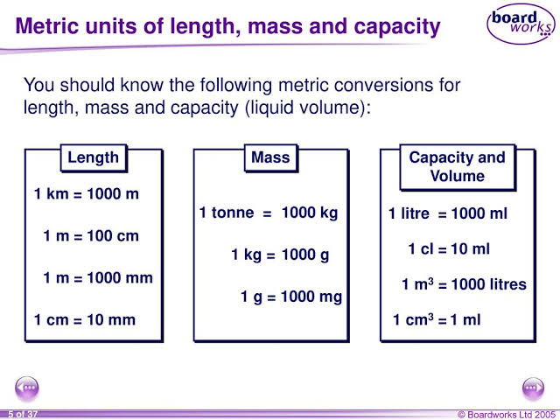

Slide 29


